Slide 1
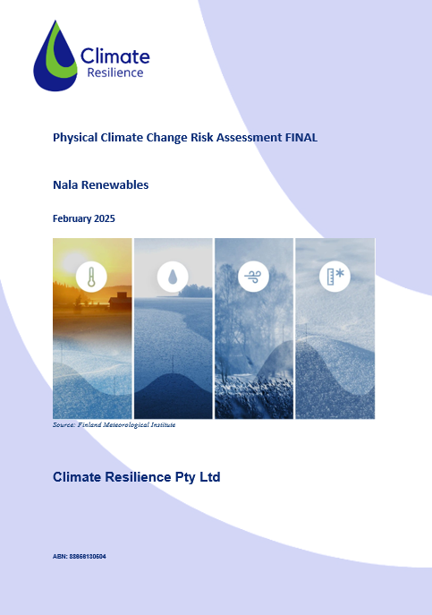
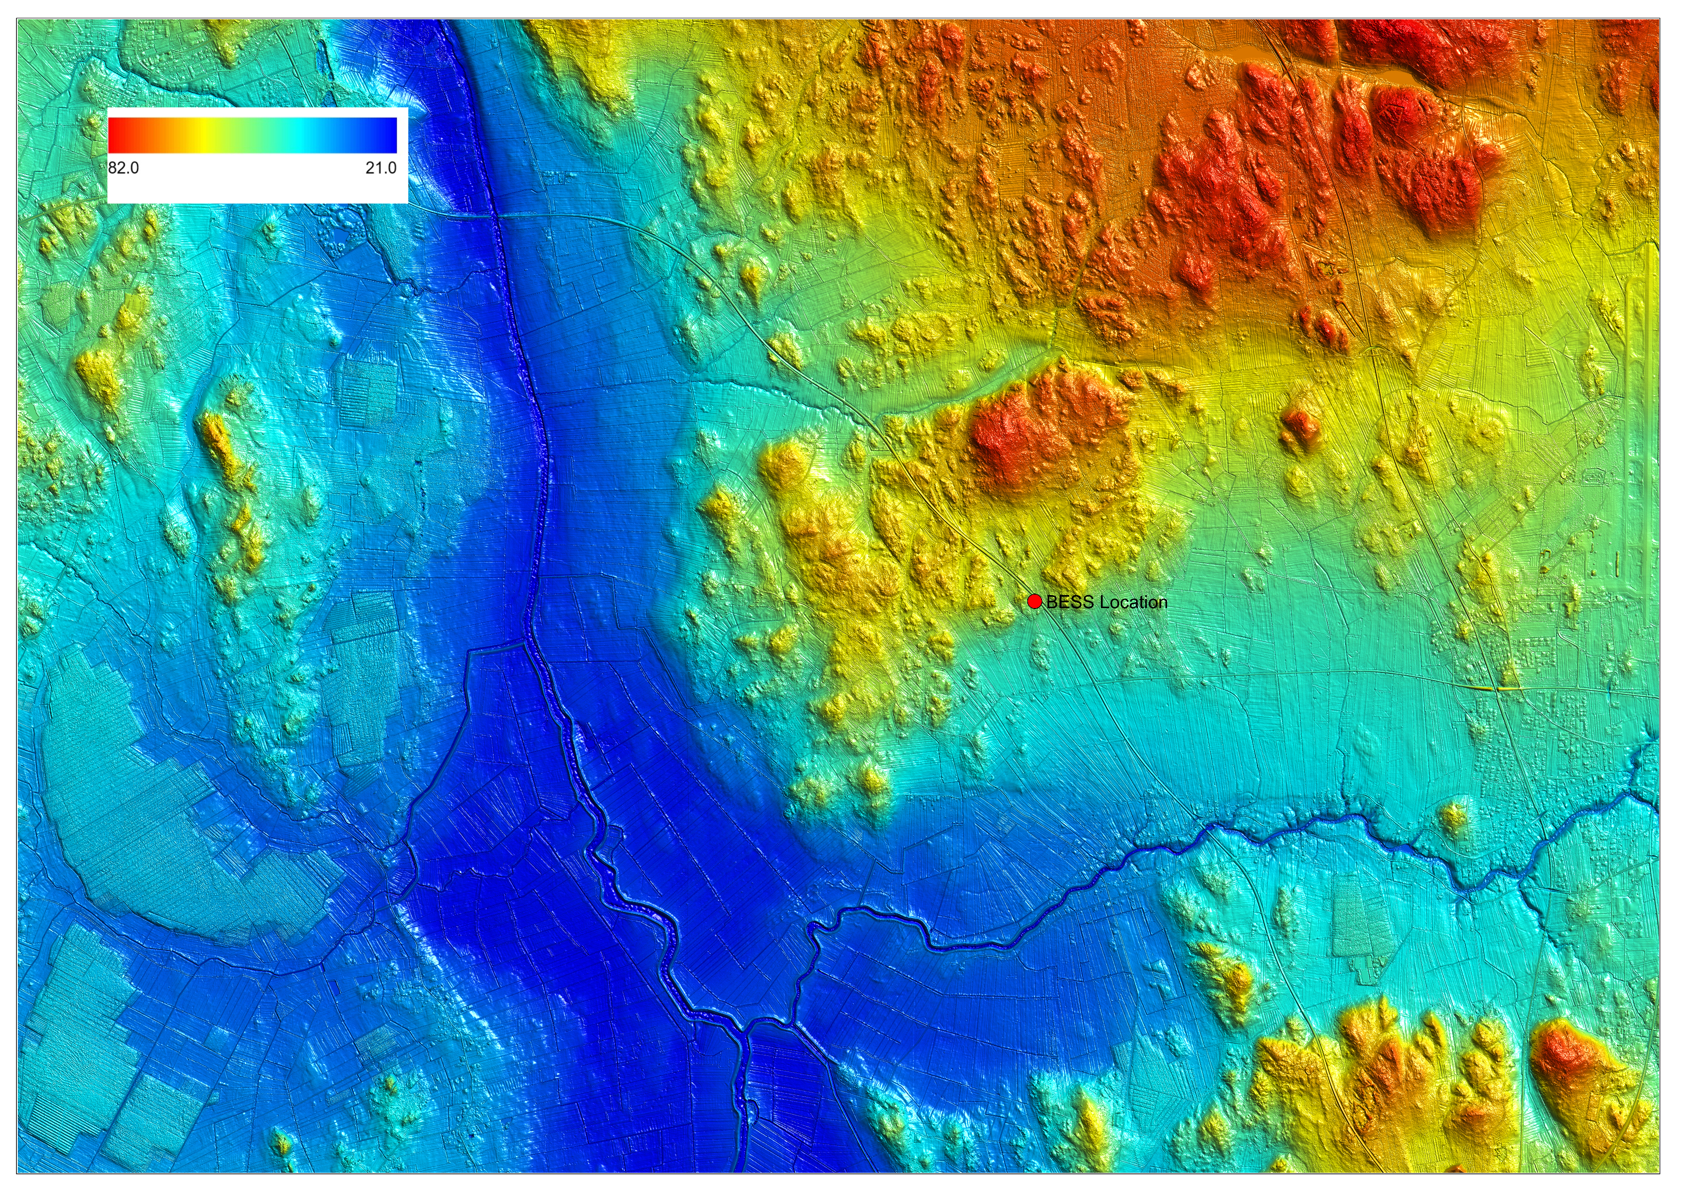
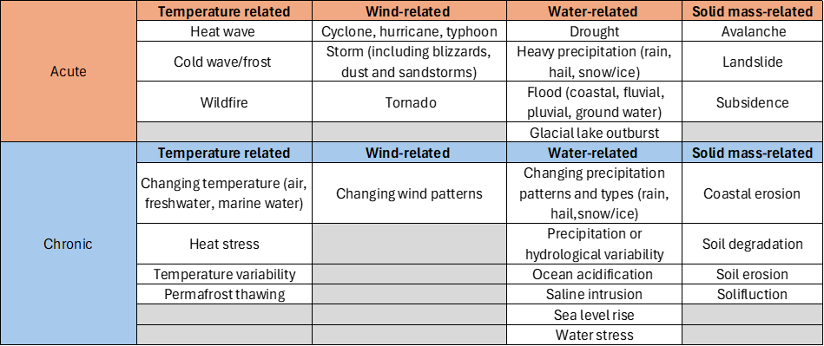
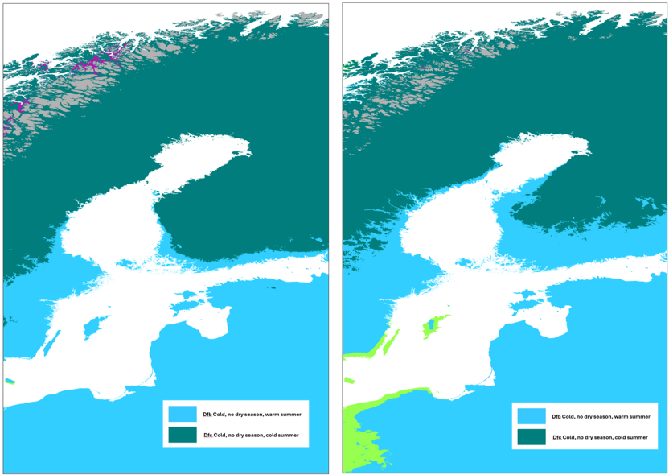
Physical Climate Risk Assessment – Finland
Client: Nala Renewables
Outcome: Allowed Nala to make an informed decision on adaptive response, prior to committing to construction, thereby factoring long term resilience into overall project cost
The Brief
Nala Renewables engaged Climate Resilience to undertake a Climate Change Physical Climate Risk Assessment (CCPRA) for a location where a proposed Battery Energy Storage System (BESS) in Central Finland.
Climate Resilience worked with the client to understand sensitivities of the asset, both for acute (short term) and chronic (longer term) hazards for investment discourse purposes.
The final report outlined existing and future site risks along with supply chain and logistics impacts and considered the potential for Black Swan climate events on the storage facility and its’ commercial functioning.
Figure 1: 2 metre Digital Elevation Model (DEM) of Finland.
Geological Change
Approach
A key consideration for the Finnish study was the inclusion of geological features. Isostatic uplift, or glacial rebound, is a key feature for European countries including the UK, Scandinavia, and Finland.
At the site, the rate at which the land is rising exceeds the rate of sea level rise by some margin, effectively meaning the sea level is falling and the impact of climate change related sea level rise is not a concern.
Physical risk assessments that incorporate all aspects of the changing environment have greater confidence and value for decision making
The approach aligns with ISO 14091 and assesses exposure and sensitivity to assess risk and allow consideration of mitigation. IPCC economic and social scenarios are represented using the Coupled Model Intercomparison project (CMIP – dataset 6) data and hazards considered are in line with social harm guidance from the European Union (EU Taxonomy DNSH - see right) with some additional factors, such as public health, depending on the location.
Existing climate assessments showed the site had already transitioned to a new Koppen climate zone by 2020, information used to inform the existing case risk more thoroughly– see right.
We consider these hazards alongside topography (see Figure 1), catchments geological, and pedological information to ensure a tailor-made, local risk assessment that considers site, supply chains, and other characteristics associated with the asset, and the function often asset. This is our point of difference: deep knowledge of and consideration of all natural processes. (see Geological Change)

